Slide 1
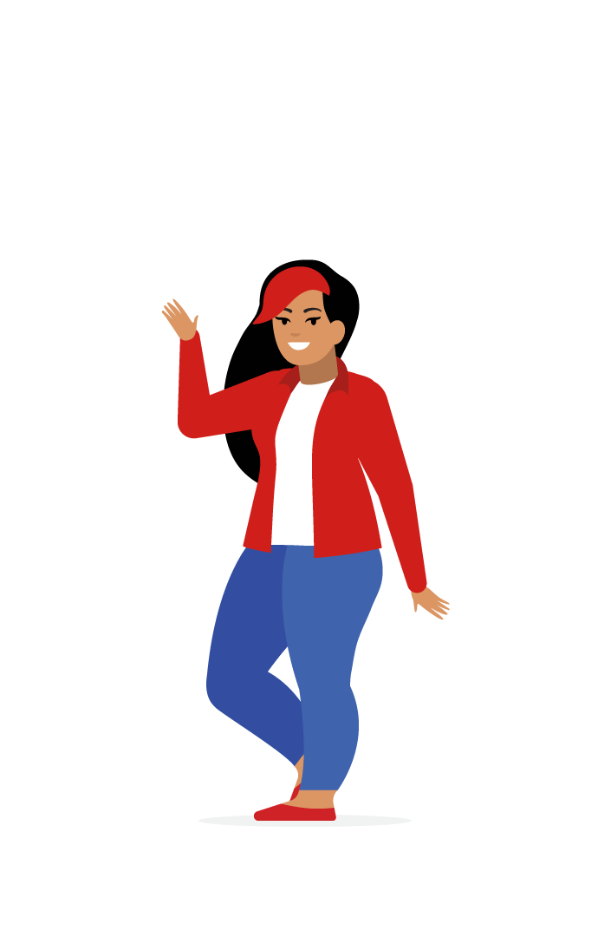
“Online shopping is my escape from my responsibilities”
Goals
Bigger buttons and improved placement for more accessible navigation.
Less cluttered navigation and layout for easier browsing.
Accurate and inclusive sizing for improved buying confidence.
Frustrations
“I struggle with the size and placement of buttons.”
“Shopping website layouts and navigation are complicated and confusing.”
“Too many websites advertise clothes that aren’t the size they actually are.”
Mahalia
Mahalia is a 19-year-old architecture student and full-time dog walker who lives with their parents. They work during the day and study at night, and enjoy browsing through clothes online during their off time to relax.
They are frustrated with their online shopping experience on mobile websites because of the size of buttons and complicated navigation. They also feel disappointed that sometimes the sizes listed on the website don’t match the size of the clothes that they order and later receive.
Age:
Education:
Hometown:
Family:
Occupation:
19
Architecture student
Jackson, Mississippi
Parents
Dog walker

